Slide 1

Recursion:
Algorithmic Designs

Slide 2
Understanding Recursion
Main function
function
Function calls itself again
Function calls itself again
Base Case
THE CORE CONCEPT OF RECURSION
Recursion is a process where a function calls itself to solve smaller instances of the same problem. It keeps repeating until it reaches a simple base case.
Returns values on every step

Slide 3
Loop VS Recursion
Recursion is preferred when:
Problem can be divided into smaller subproblems
Working with hierarchical structures
Clarity is more important than speed
Loops are preferred when:
Efficiency is critical
Task is linear and repetitive
Memory use must remain low

Slide 4
Real-Life Applications of Recursion
Computer Science Uses
Graph traversal
Sorting
Mathematical Uses
Factorial
Fibonacci
Complexity OF RECURSION (O(n))

Slide 5
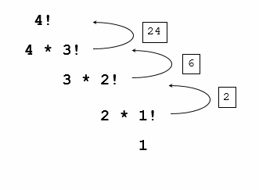
Simple Examples
FACTORIAL
Calculates the product of all positive integers.
6!

Slide 6
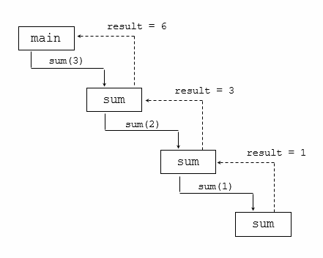
Simple Examples
FIBONACCI
Generates a sequence where each number adds previous.

Slide 7

Algorithm of Fibonacci
Algorithm of Fibonacci according to Recursion
STEP1. FUNCTION fib(n)
STEP2. IF n ≤ 1 THEN RETURN n
STEP3. ELSE
RETURN fib(n-1) + fib(n-2)
[END OF IF STRUCTURE]
STEP4. END FUNCTION

Slide 8
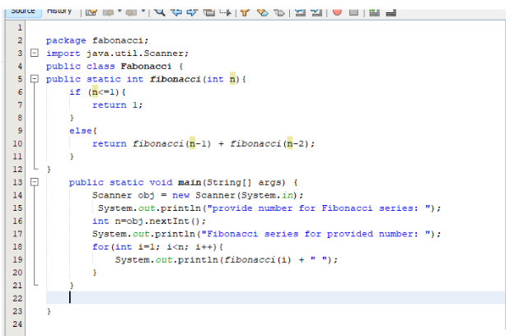
Program of Fibonacci

Slide 9
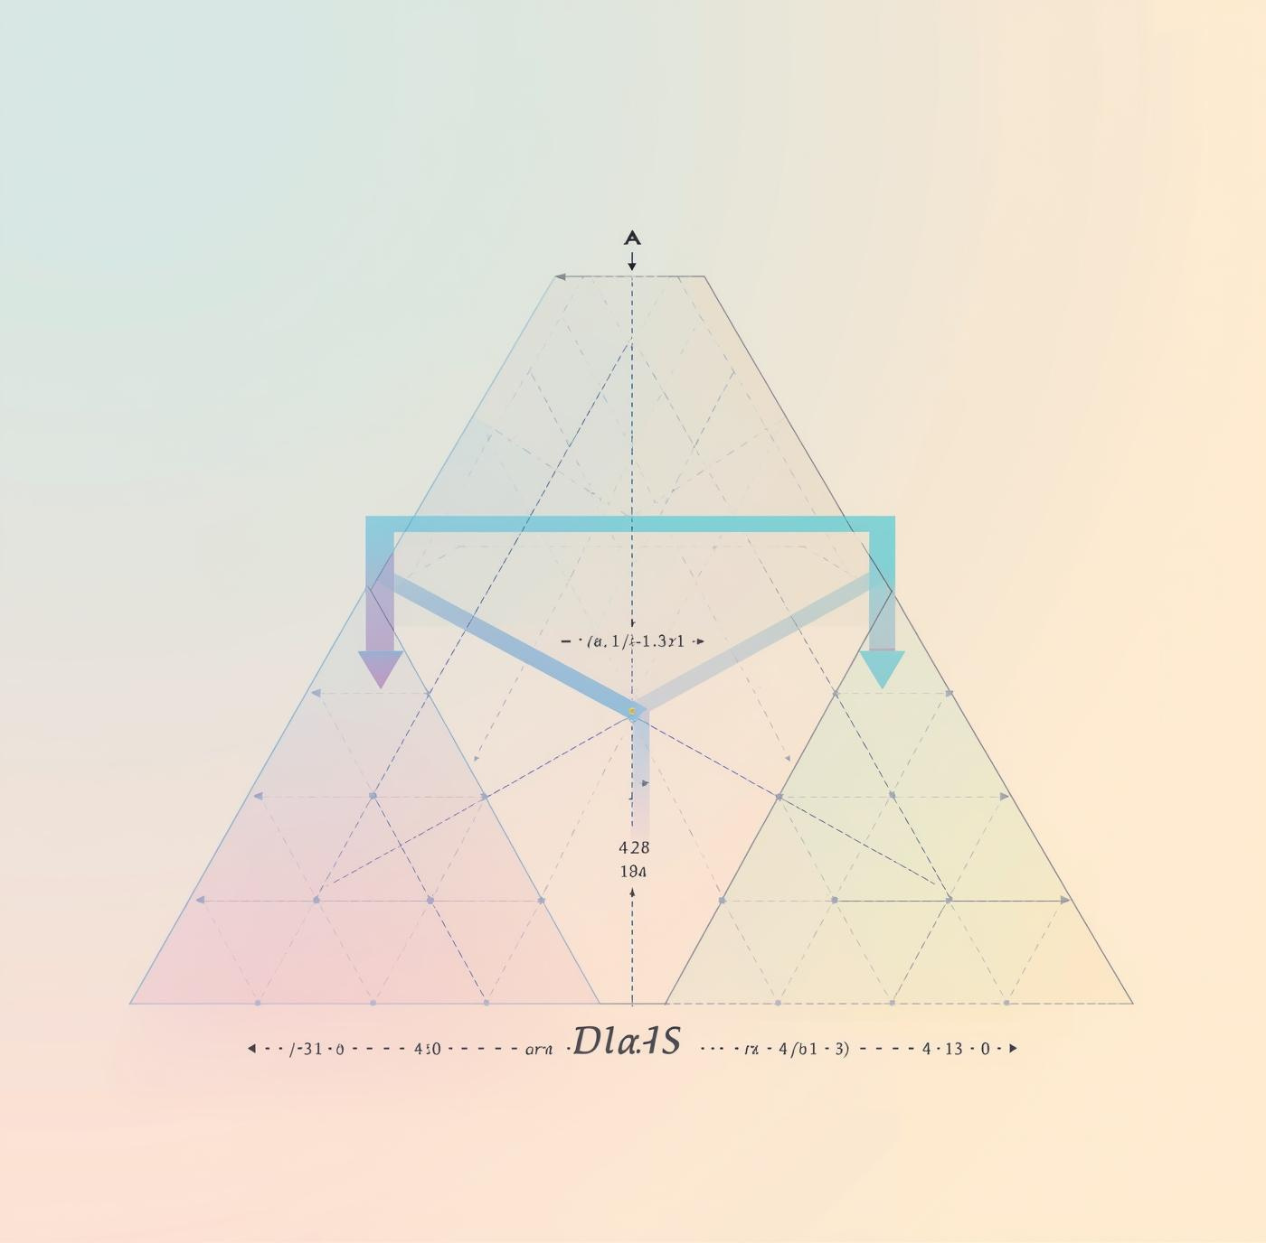
Algorithm of Factorial
Algorithm of Factorial according to Recursion
STEP1. FUNCTION fact(n)
STEP2. IF n = 1 THEN RETURN 1
STEP3. ELSE
RETURN n * fact(n - 1)
[END OF IF STRUCTURE]
STEP4. END FUNCTION

Slide 10
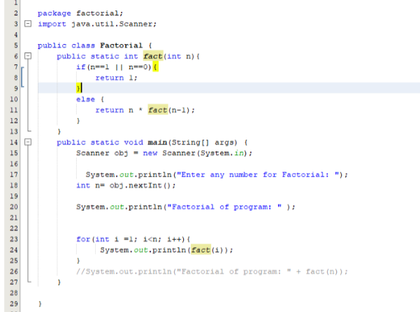
Program of Factorial

Slide 11
Thank You

